Slide 1
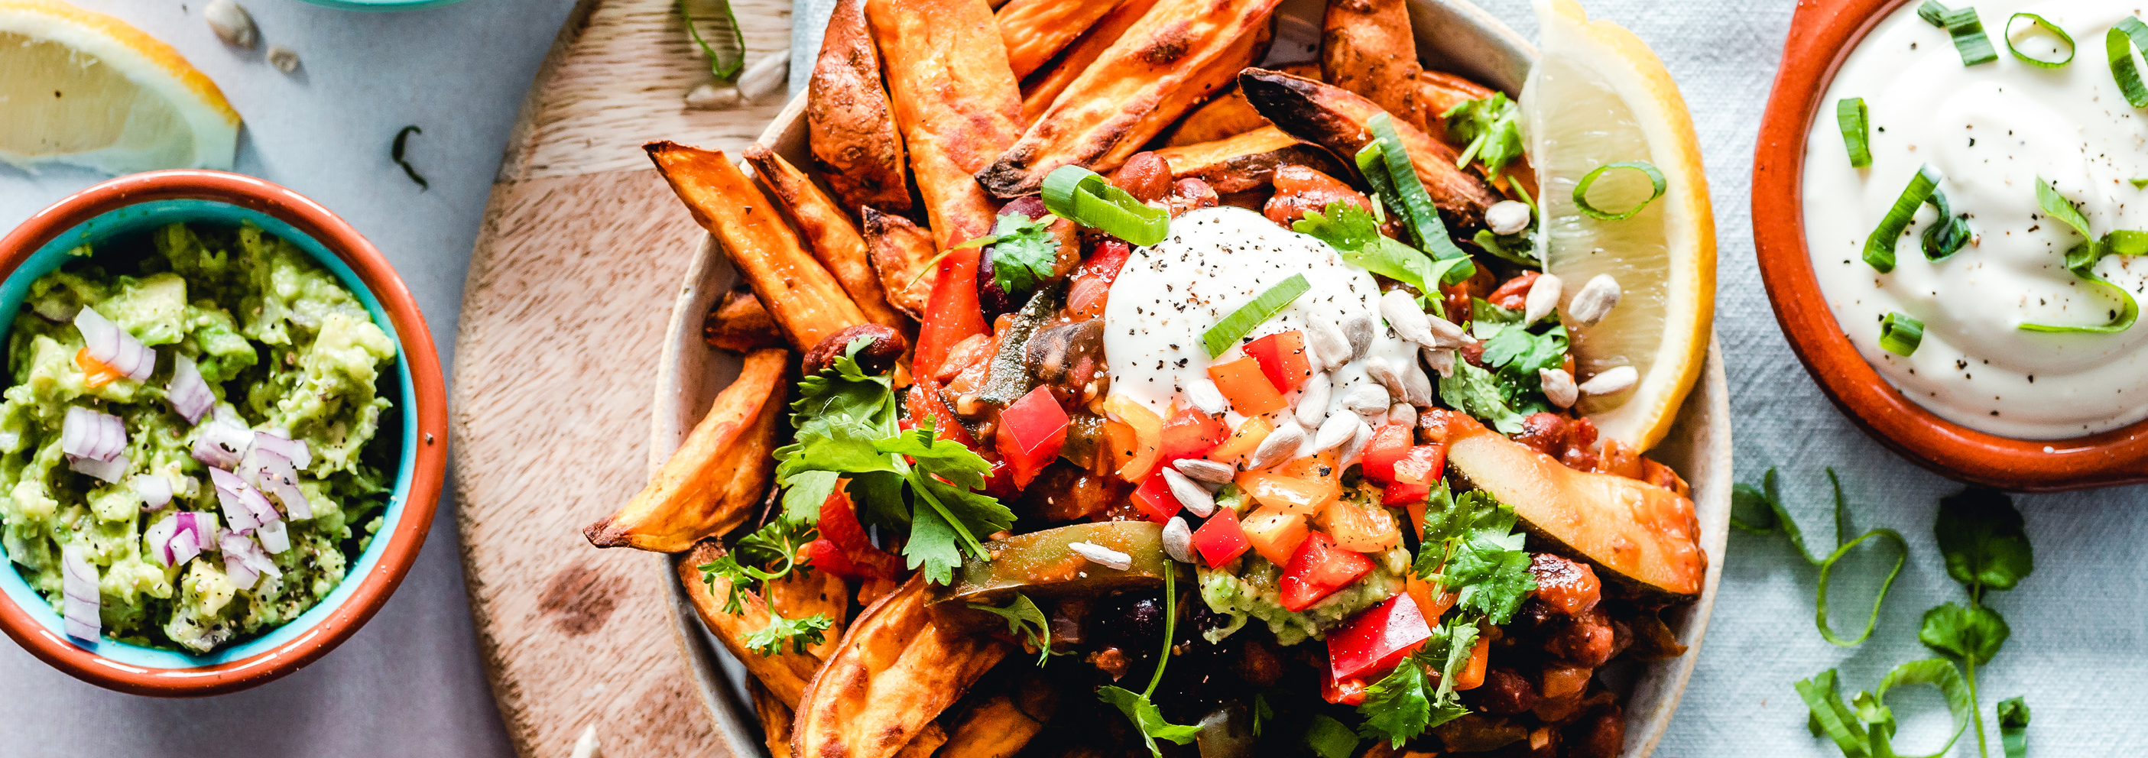


Austen Tech
TIFFIN ONLINE BOOKING PRESENTATION
TAKING OUR COMPANY TO THE NEXT LEVEL

Slide 2
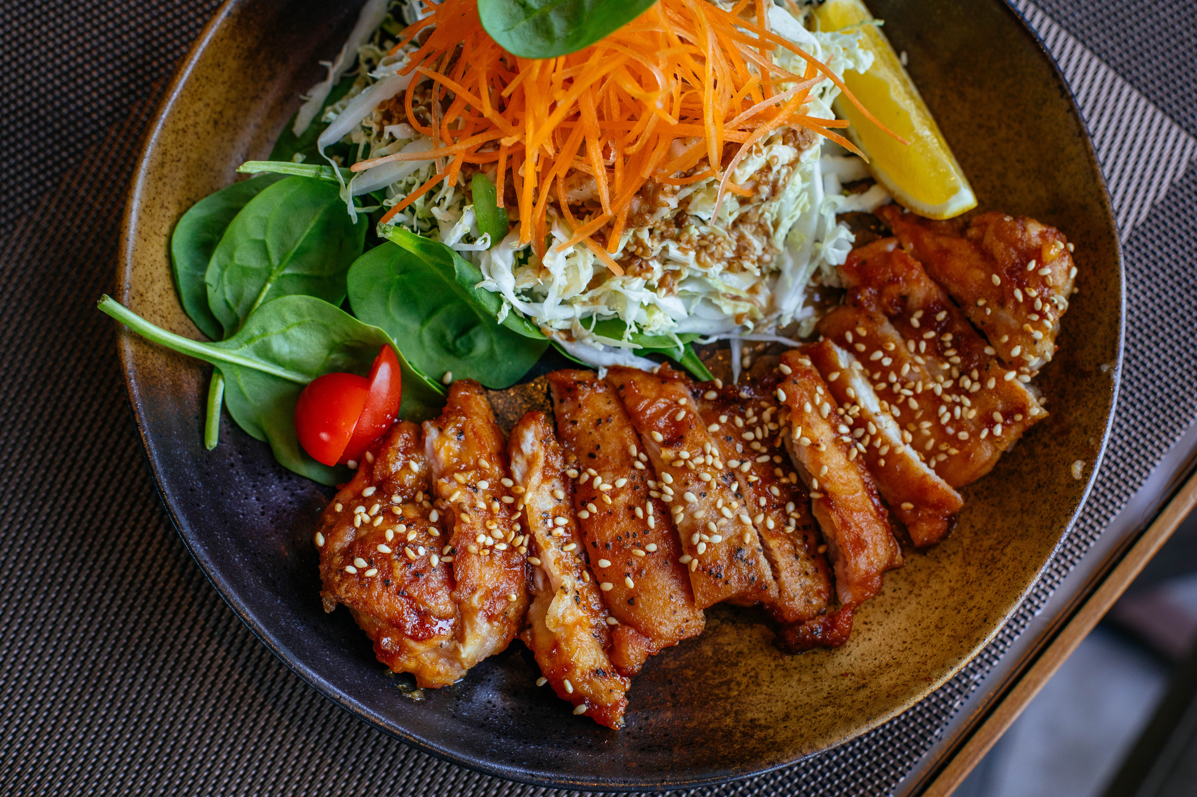

ABSTRACT
This project provides a Web page application through which
people who can order Dabba service online using the internet.
The aim of doing this project is to have practical knowledge of
dabbawalas team and their actual performance in the supply and
management of food delivery service.
In our busy schedule fresh and homemade food preparation is
difficult in early mornings. But it is made possible by Dabbawala's.

Slide 3
INTRODUCTION
It incurs more time as well as information is been stored on paper which increases paperwork and makes record maintenance tedious, rather than that there aren't available for some of the time when they are performing their function while in this period you cant avail the services provided by them which leads to non-availability.
This leads to inconsistency and if any accident happens there is no backup available for them
The proposed system focuses on developing an application which will be available to the users with ease and can perform the actions without any restrictions according to their needs.
As the application, will be available on the hand-held devices it can be accessed anytime, anywhere to book the services which will eliminate the constraint of non-availability.
From the side of dabbawalas it will ensure that efficiency, stability and integrity are being maintained of the data regarding their business.

Slide 4
EXISTING SYSTEM
This existing system is not very reachable
A customer willing to avail the dabbawala service needs to go around and find for a dabbawala or their office for registering himself which consume a lot of time and resource, which making the system less accessible.
DISADVANTAGES
Can order food only from restaurants or applications providing restaurant services

Slide 5


PROPOSED SYSTEM
This propose system is very much accessible and accomplished
This online service crack the distance between the service and the customer by using modern technology.
Awebpage is created where any mumbaikar can register, book the services and get access to the information regarding availability of the service.
It is a boon for health conscious office worker who can't travel home for lunch or don't want to eat in a café or restaurant everyday, still enjoy the delicacy of home food.
ADVANTAGES
can order home made food which the dabbawala prepare at home and deliver to us through this webpage.
dabbawala also deliver our own home food from our house by giving our name, phone number
home address through this webpage
It eliminates the use of ordering through phone that causes incessant load on the workers in
taking and processing orders whereas online ordering automates this process.
Customers can order online at any time of the day.
There is a confirmation of the order taken online which is sent to the user via email
DISADVANTAGES
CANNOT CANCEL THE ORDER ONCE GIVEN.

Slide 6

SOFTWARE REQUIREMENT SPECIFICATION

Slide 7

FUNCTIONAL REQUIREMENT
SCOPE
PURPOSE
In the current system, if any one wants to subscribe for services of dabbawala then customer needs to contact the service provider of dabbawalas via a phone call or
need to visit their office and avail the services
It will reduce the cost of labour and provide integrity and consistency with respect to
calculation of cost of the services and the paper work will be eliminated that will
eliminate the space issues for storing the files and accessibility of previous record
can be done at any time.

Slide 8

NON FUNCTIONAL REQUIREMENT
THE MAJOR NON-FUNCTIONAL REQUIREMENTS OF THE SYSTEM ARE AS FOLLOWS
SUPPORTABILITY
USABILITY
The system is designed to be the cross
platform supportable. The system is supported on a wide range of hardware and any software platform, which is having abstraction, built into the system.
The system is designed with completely
automated process hence there is no or
less user intervention
RELIABILITY
IMPLEMENTATION
The system is more reliable because of
the qualities that are inherited from the
chosen platform MySQL, Eclipse , Visual Studio Code.
The system is implemented in web environment using SDL framework. The Springboot is used as the web server and windows XP professional is used as the platform. Interface the user interface is based on HTML Tag.

Slide 9
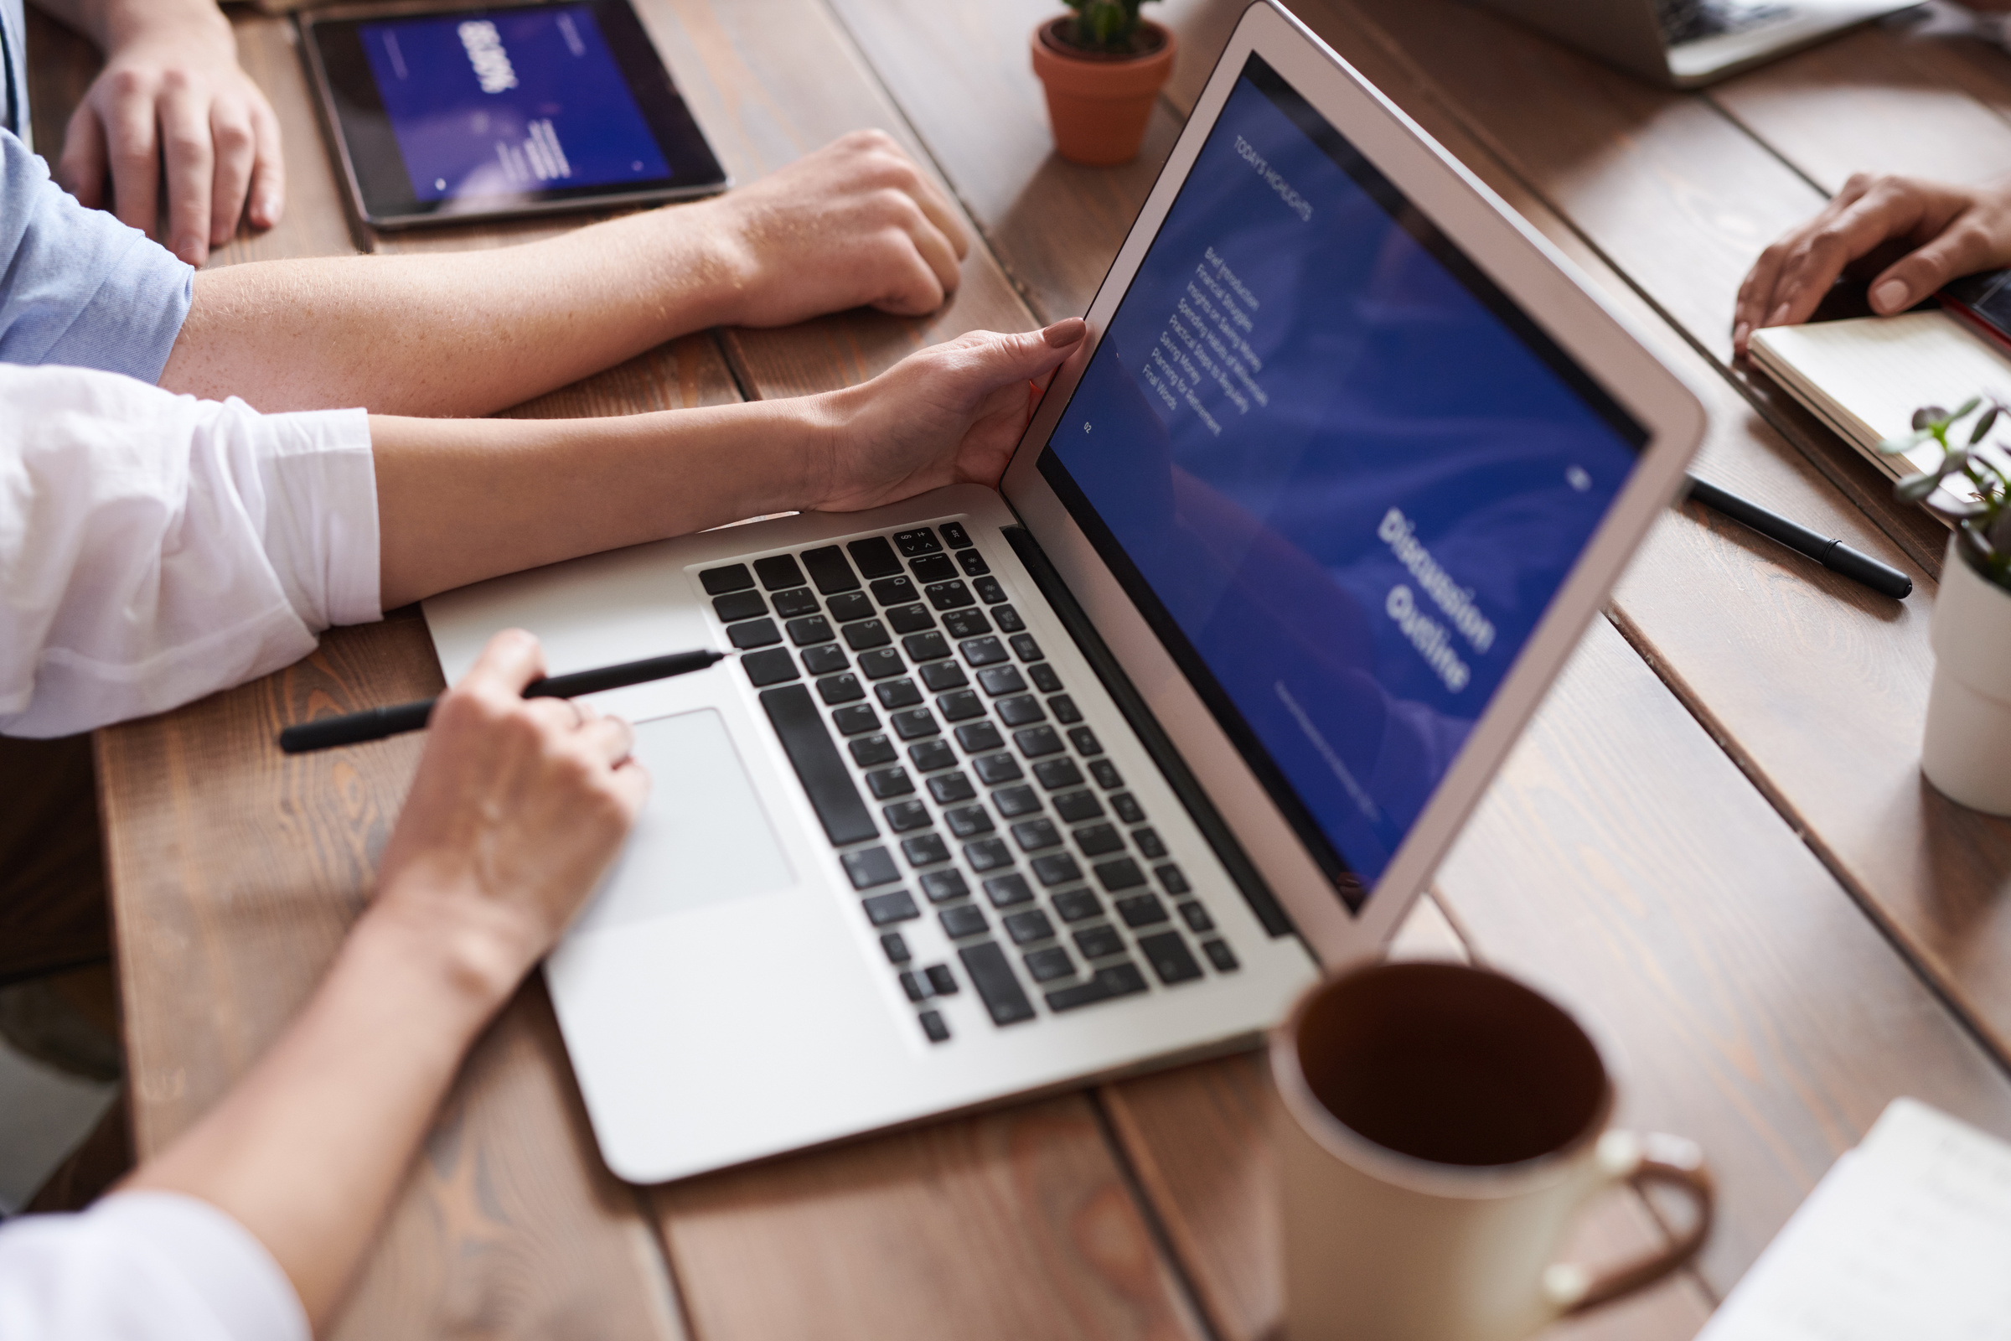
PERFORMANCE
This system is developing in the high- level languages and using the advanced front-end and back-end technologies it will give a response to the end-user on the client system within very less time

Slide 10


MODULES

Slide 11
1 ONLINE USER LOGIN
INPUT
User credentials are given as input such as user name, password phone number
PROCESSING
In this step this user information will be passed using post methods and stored in database table of user information.
OUTPUT
The user information will be stored in user table.

Slide 12
2.ONLINE ORDERING FACILITY
INPUT
User information , lunchbox and lunch box type will be loaded.
PROCESSING
In this orders will be created in lunchbox order table.
OUTPUT
Here lunchbox from restaurants will be accepted as orders.

Slide 13
3.HOMEMADE TIFFIN
INPUT
Here user information, office address , home address will be given as input.
PROCESSING
In this processing user address, street number, door number , of the user's lunchbox will be processed and accepted.
OUTPUT
Only homemade orders will be accepted in this module.

Slide 14
4.ADMIN MODULE
INPUT
In this admin credentials are given as input.
PROCESSING
Admin credentials such as user name, password, admin phone number, will be given as input first registered then stored as admin credentials
OUTPUT
All the transaction data such as orders, user information, lunchbox delivery boys information will be displayed on the page.

Slide 15
5.E-MAIL NOTIFICATIONS
INPUT
User E-mail will be loaded from user table and given as user input
PROCESSING
The E-mail information loaded from user table as well as lunchbox delivery boys table will be activated and mail will be sent respected
OUTPUT
E-mail will be sent to each and every user.

Slide 16
Conclusion of Online Tiffin Booking System:
Finally, in the Online Tiffin booking system, we have developed a secure, user-friendly Tiffin Management System. This System can take care of each member whether it is an Administrator or a Customer. This System will help them to properly manage the meals of the customers, the delivery boy’s data, and help in growth without creating any hassle.
This system is completely secure since every user is provided with a user ID and Password so there is no chance of any unauthorized access. Online Payment, Registration, and cancellation make it easier to use. So, using this system will help in reducing the labor and provide more facility for Customers to like the services.

Slide 17


